Slide 1
JasperReports

Slide 2
Embedded Analytics & Reporting Platform | Jaspersoft
https://www.jaspersoft.com/
Jaspersoft Community Edition - Free Reporting Software, Open Source
https://www.jaspersoft.com/products/jaspersoft-community

Slide 3



Slide 4
Community Edition - Jaspersoft Community
https://community.jaspersoft.com/download-jaspersoft/community-edition/
JasperReports Library
Jaspersoft Studio

Slide 5
Jaspersoft Studio
JasperReports is an open source Java reporting tool that can write to a variety of targets, such as: screen, a printer into PDF, HTML, MSExcel, RTF, ODT, Comma-Separated Values (CSV), or XML files
it can be used in Java-enabled applications, including Java EE or web applications, to generate dynamic content
reads its instructions from an XML or .jasper file
several Java Integrated Development Environments, such as NetBeans, Eclipse, … provide instructions for users wishing to integrate JasperReports into project

Slide 6
Jaspersoft Studio
Linux
MacOS
Windows

Slide 8
Getting Started with Jaspersoft Studio - 9.0.0 - Jaspersoft Community
https://community.jaspersoft.com/documentation/jaspersoft%C2%AE-studio/tibco-jaspersoft-studio-user-guide/v900/jss-user-_-getting-started/
JasperReports Tutorial
https://www.tutorialspoint.com/jasper_reports/index.htm

Slide 10
Business Intelligence reporting
process of collecting, analyzing, and presenting data to inform business decisions
critical tool for businesses of all sizes, as it can help them to identify trends and patterns in their data, understand their customers better, and make better decisions about their products, services, and marketing, thereby improving their operational efficiency

Slide 11
Reports
Dashboards provide a visual representation of key metrics, facilitating a quick grasp of complex information
Data visualization such as charts and graphs, enabling users to discern patterns and trends effortlessly
interactive reporting features empower users to drill down into specific data points, fostering a deeper understanding of the nuances within the dataset

Slide 12
Key Performance Indicator (KPI)
a performance indicator or key performance indicator (KPI) is a type of performance measurement; evaluate the success of an organization or of a particular activity in which it engages
provide a focus for strategic and operational improvement, create an analytical basis for decision making and help focus attention on what matters most

Slide 13
Dimensional modeling
includes a set of methods, techniques and concepts for use in Data Warehouse design
approach focuses on identifying the key business processes within a business and modelling and implementing these first before adding additional business processes, as a bottom-up approach
dimensional model is built on a star-like schema or snowflake schema, with dimensions surrounding the fact table

Slide 14
Dimensional modeling
uses the concepts of facts (measures), and dimensions (context)
facts are typically (but not always) numeric values that can be aggregated
dimensions are groups of hierarchies and descriptors that define the (context of) facts

Slide 15
for example, sales amount is a fact; timestamp, product, store, etc. are elements of dimensions
dimensional models are built by business process area

Slide 16
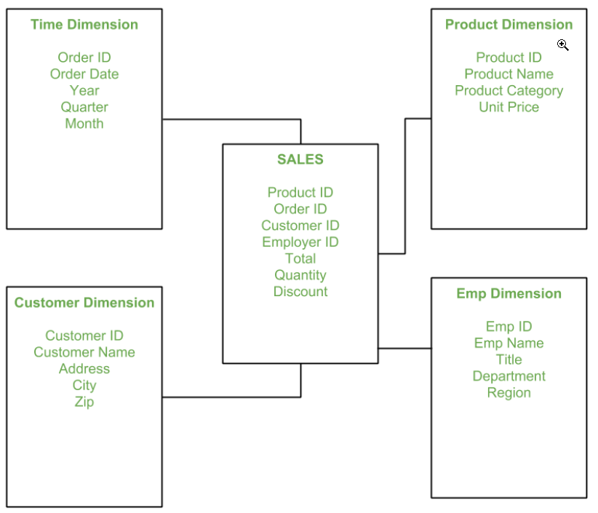

Slide 17
Jaspersoft Studio
enables to create highly formatted, pixel-perfect designed reports and data visualizations that meet any requirements and can pull from the widest selection of data sources
built on an open source foundation and we continue to embrace that philosophy
community edition provides access to extensive JasperReports Library and Jaspersoft Studio
JasperReports Library written entirely in Java, runs anywhere; can deliver beautifully rendered reports and other data visualizations from raw data
simple, flexible, and configurable API for developers to interface with and can easily adapt to various needs when embedded into Java application

Slide 18
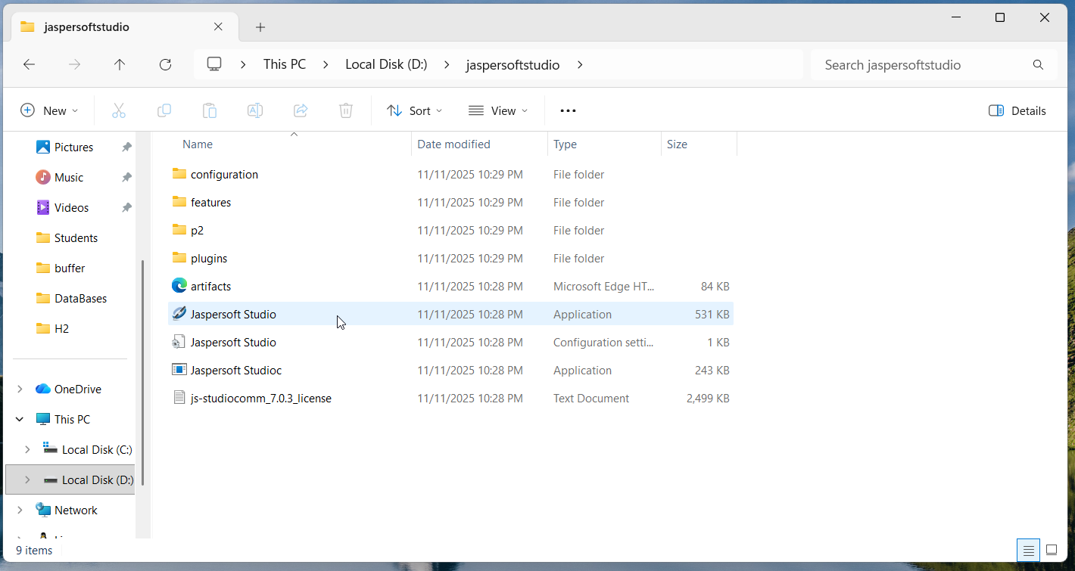
download js-studiocomm_7.0.3_windows_x86_64.zip

Slide 19
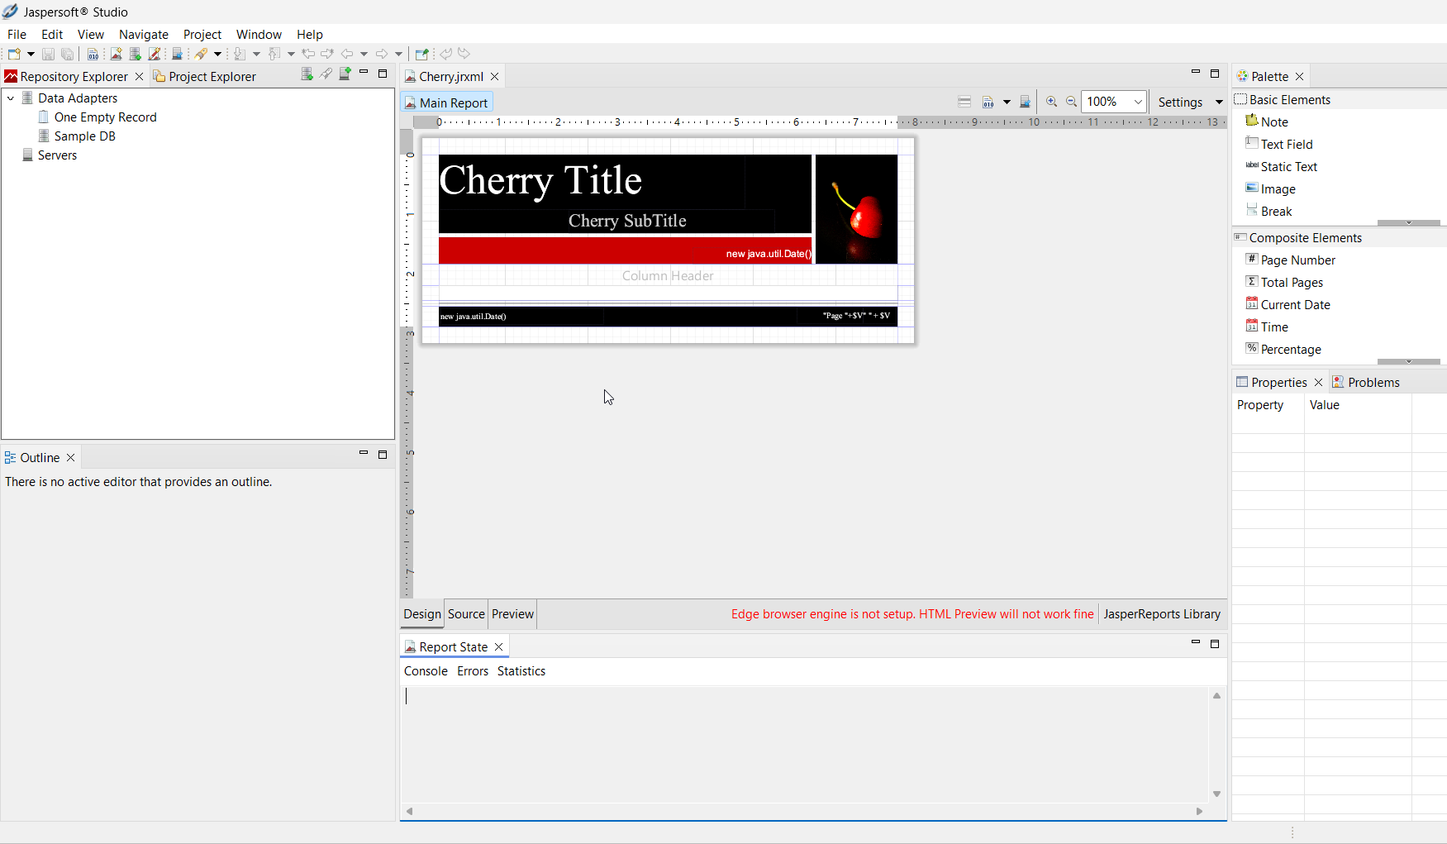

Slide 20
Simple Report

Slide 21

Creating a New Report
to create a new report:
go to File > New > Jasper Report or click on the main toolbar
New Report Wizard window displays the Report Templates page
Jaspersoft Studio includes a number of pre-installed templates; you can also create your own

Slide 22
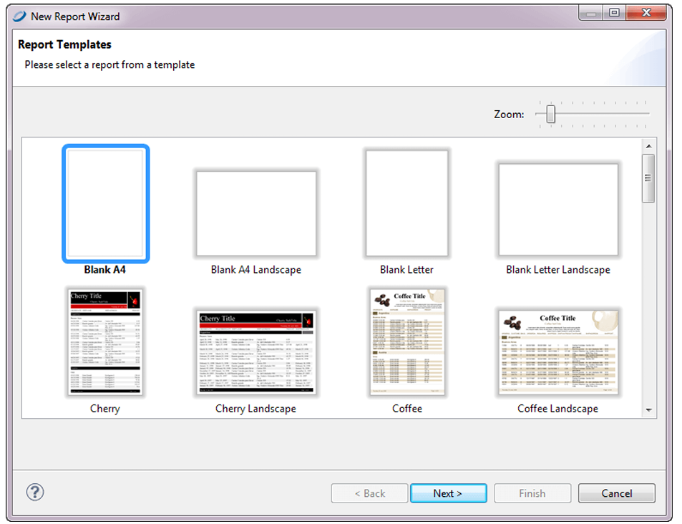
New Report Wizard

Slide 23
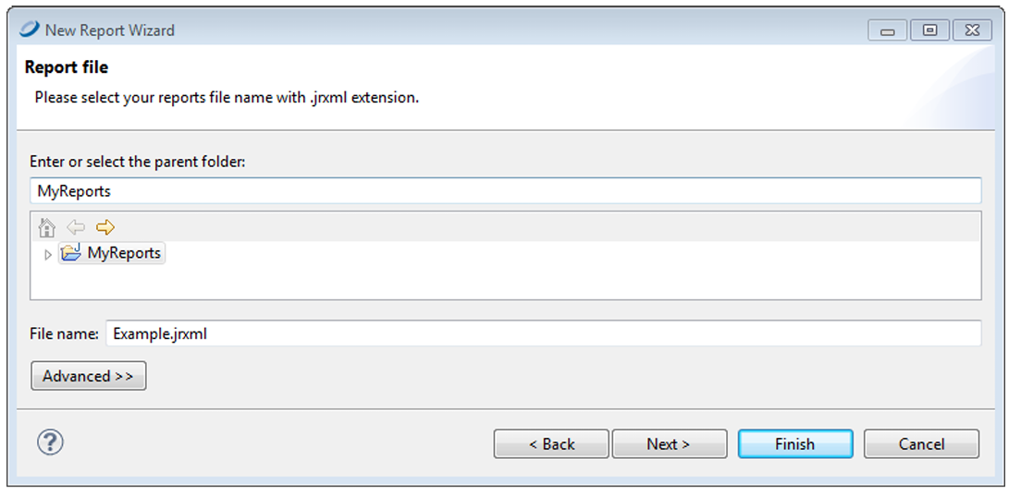
choose blank, Cherry, Coffee, Flower, Leaf, … template and click Next
the New Report Wizard shows Report file page

Slide 24
navigate to folder you want the report in and name the report
click Next; the Data Source dialog opens

Slide 25
Data Source dialog
choose the data that will fill the report
drop-down menu shows the pre-installed data adapters as well any data adapters you have added

Slide 26
adapters pre-installed:
  One Empty Record – Empty rows: lets you create report without data
  Sample DB – Database JBDC Connection: connects to an relational SQL database provided with Jaspersoft Studio installation; must also supply an SQL query
can createa data adapters … or click New ... to create data adapter directly from this dialog

Slide 27
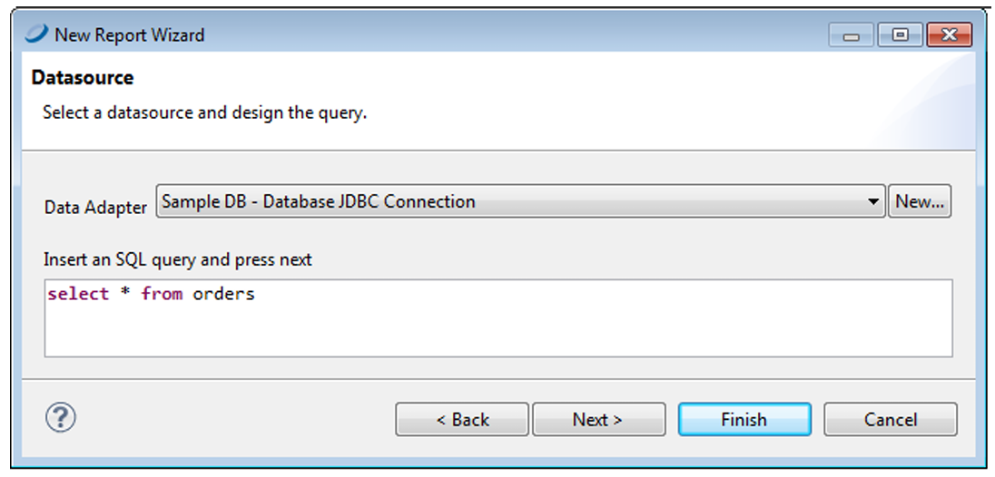
choose Sample DB- Database JDBC Connection enter the query select * from orders

Slide 28
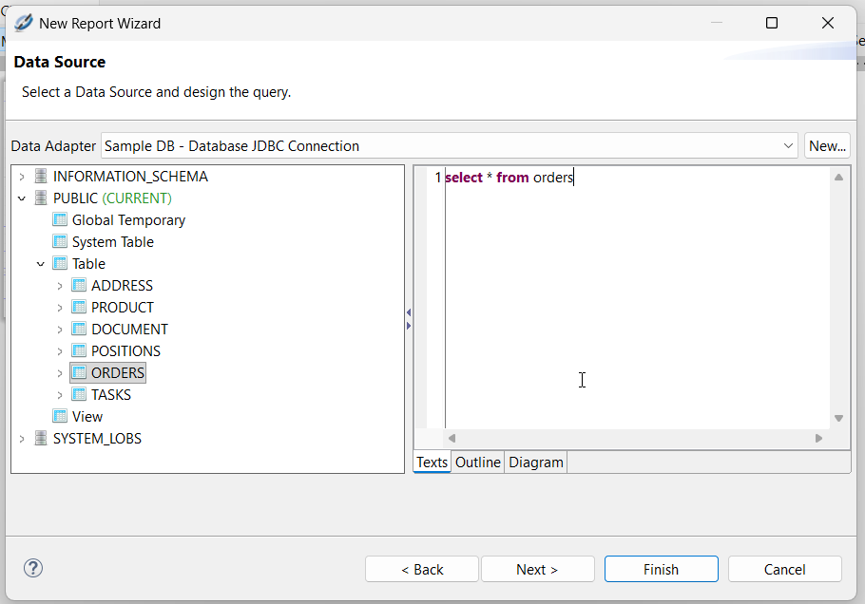

Slide 29
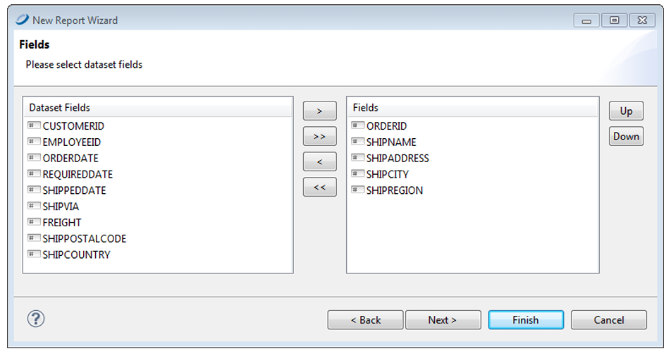
click Next the Fields window appears; Dataset list shows all discovered fields
select following fields
  and click right arrow
  to add them to report
click Next
  Grouping window appears
click Next and Finish

Slide 30
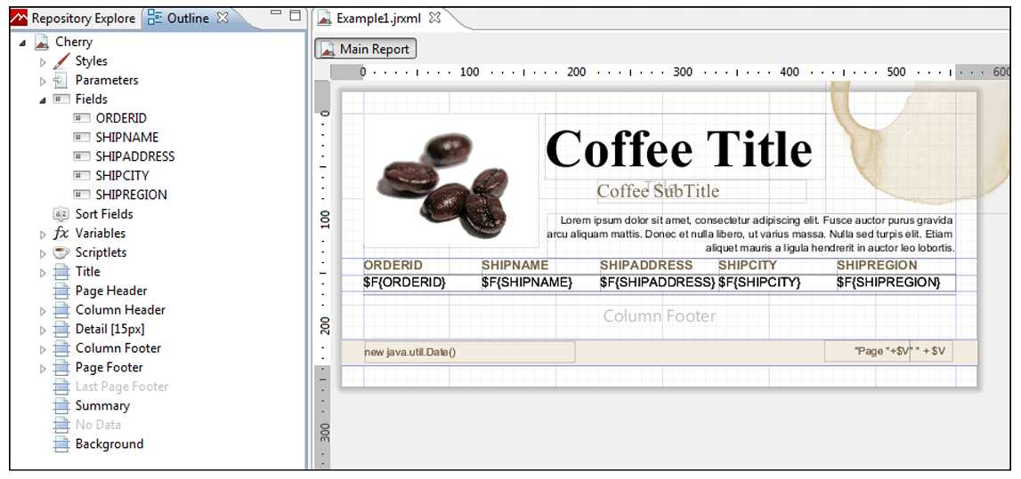
Report in the Design Tab

Slide 31
C:\Users\Operator\
JaspersoftWorkspace\MyReports
My1stCoffeeReport.jrxml
JasperReport XML template report

Slide 32
Previewing a Report
click the Preview tab at the bottom of the report

Slide 33
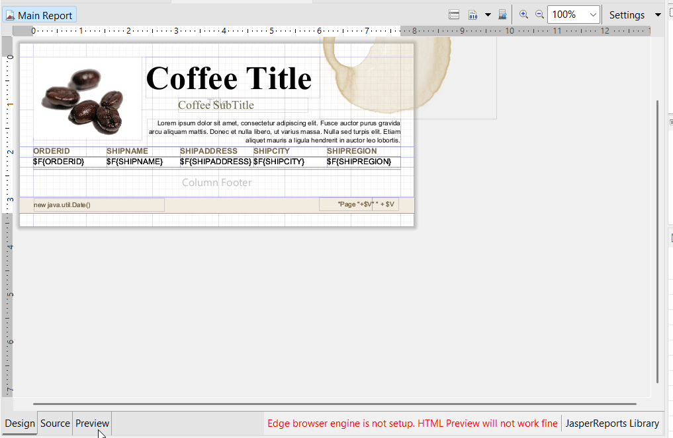

Slide 34
the preview compiles the report in the background with data retrieved by the query through your JDBC connection
the Detail band repeats for every row in the query results, creating a simple table report:

Slide 35
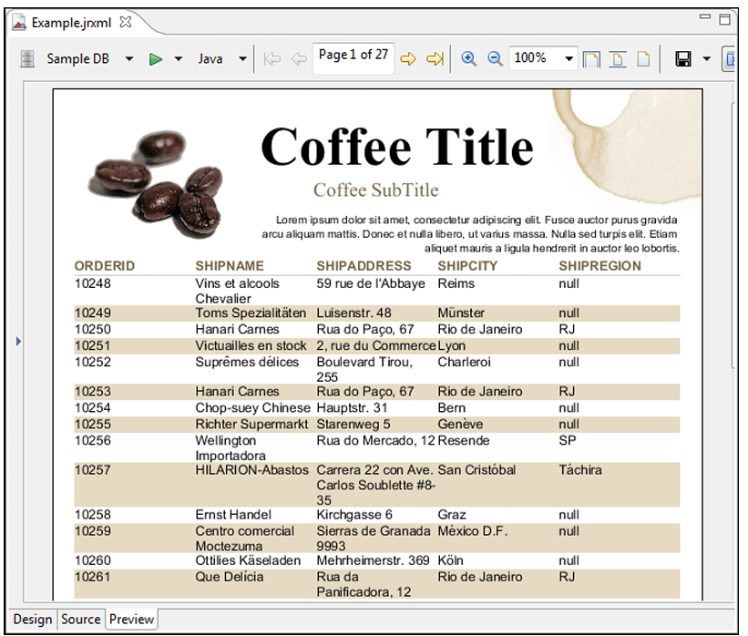

Slide 36
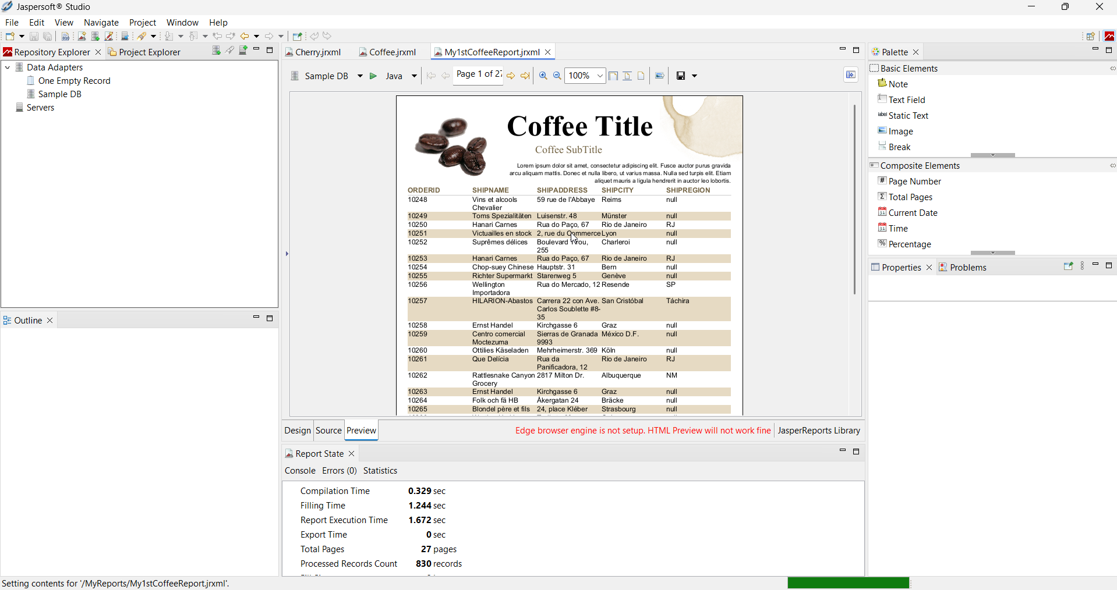

Slide 37
Create Project Folder
project folders help you organize reports
to create a project folder: choose File > New > Project ...

Slide 38
DataBase

Slide 39

Work with Database
a JDBC connection lets you use a database accessed through a JDBC driver (such as a relational DBMS)
when use JDBC connection in report, must specify a query
to create a new JDBC connection:
  create connection globally
    right-click Data Adapters in Repository Explorer and choose Create Data Adapter
  to create connection local to project, click:
    enter name and location for data adapter in Data Adapter File dialog box, and then click Next; Data Adapter wizard appears

Slide 40
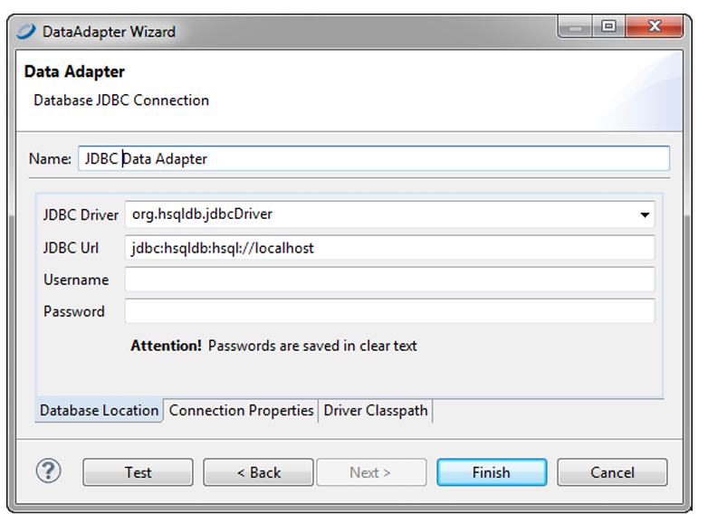
from the list, select Database JDBC connection to open Data Adapter dialog

Slide 41
configuring a JDBC Connection
name the connection - name that will appear on the list of available connections when you create report
in the JDBC Driver field, specify the JDBC driver to use for your database connection
  drop-down displays names of most common JDBC drivers

Slide 42
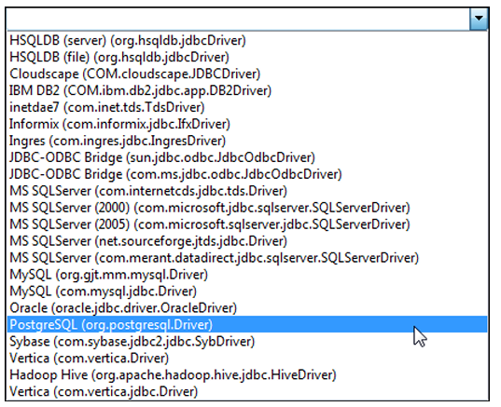

Slide 43
if driver is displayed in red, the JDBC driver class for that driver is not present in the class path and you must obtain and install the driver before using it

Slide 44
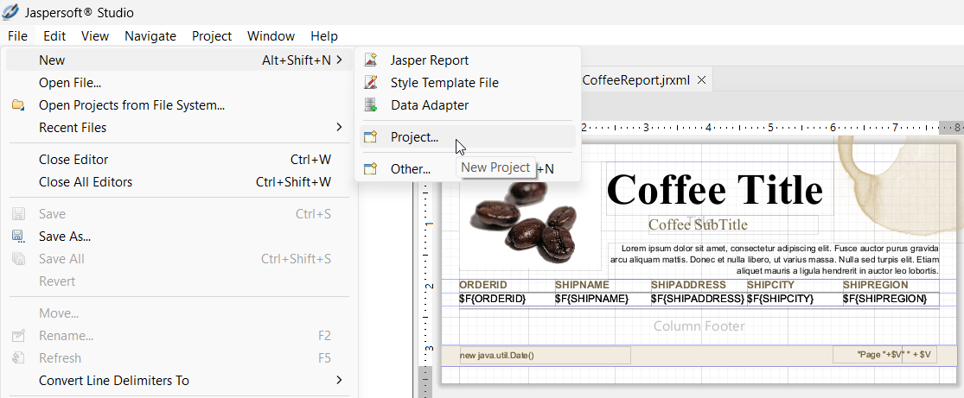

Slide 45
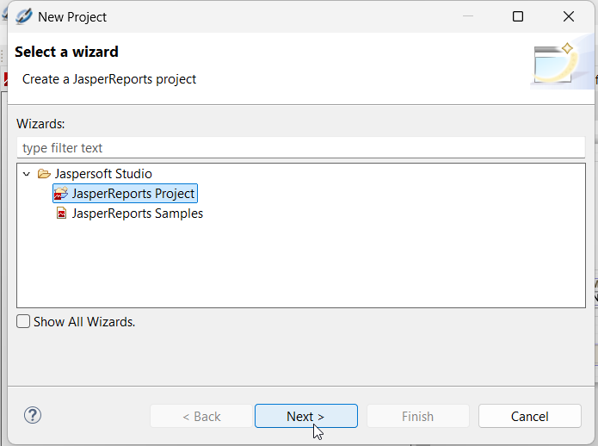
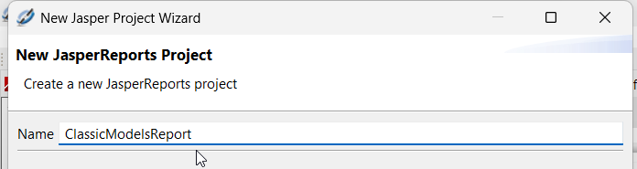

Slide 46
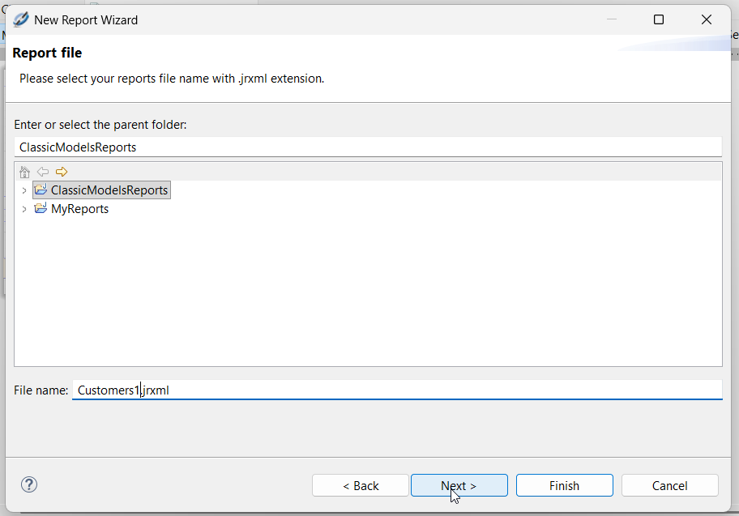
File >
New >
Jasper Report

Slide 47
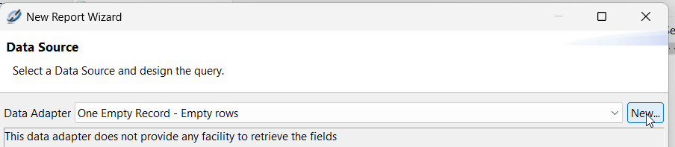
New Data Source

Slide 48
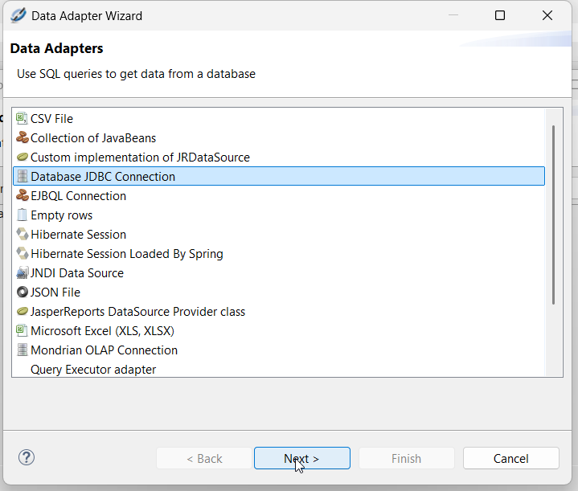
Database JDBC Connection

Slide 49
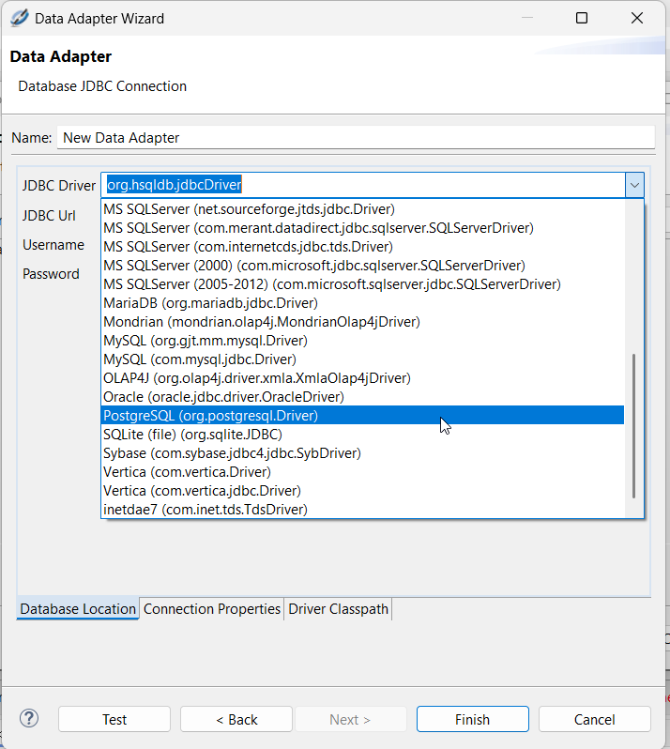

Slide 50
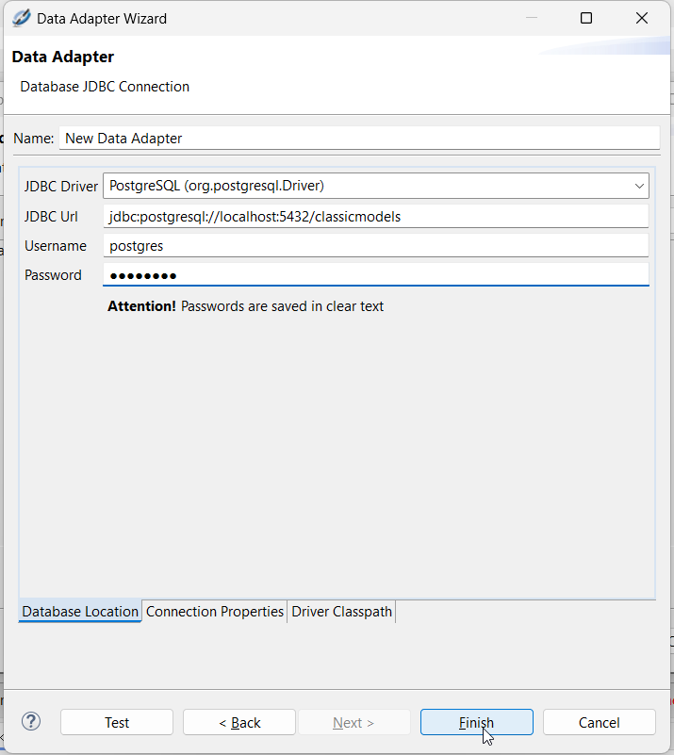
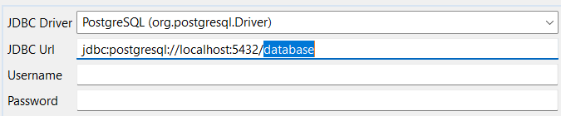

Slide 51
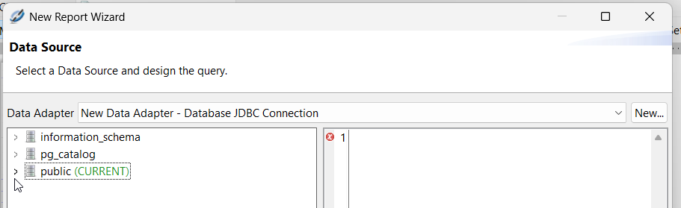

Slide 52
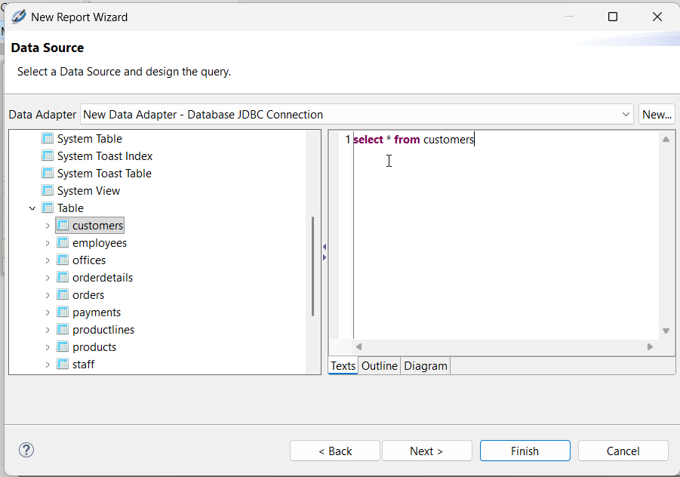

Slide 53
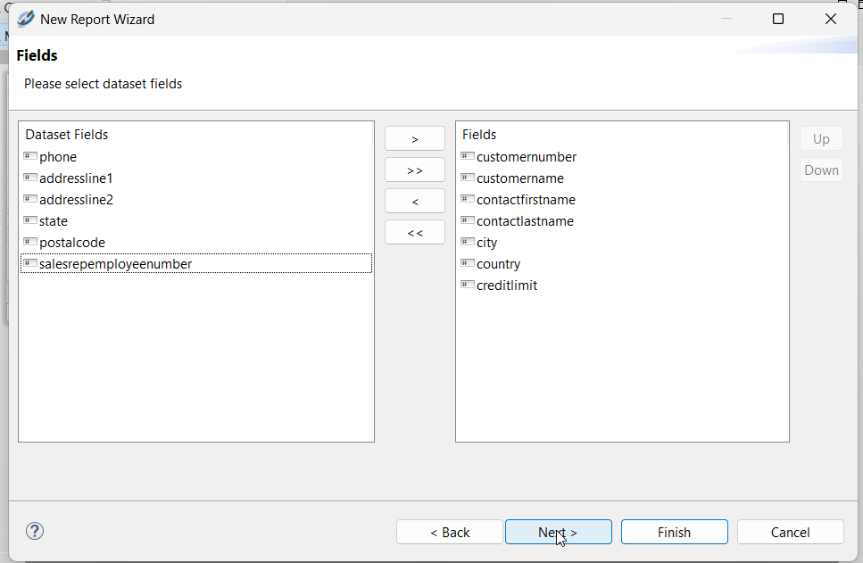

Slide 54
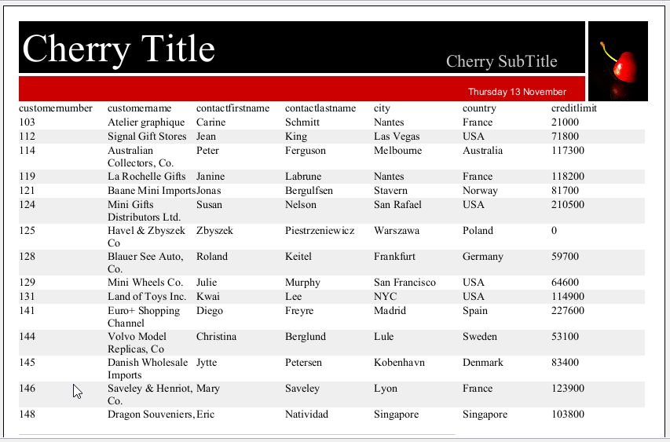

Slide 55
Northwind

Slide 56
Northwind
PostGreSQL
H2
…

Slide 57
Northwind
Measures / Fact
Sales Quantity: order_details.quantity
Sales Amount: order_details.quantity * order_details.unit_price
discount: order_details.discount * Sales Amount (order_details.quantity * order_details.unit_price)

Slide 58
Northwind
Dimension / Context
suppliers.company_name
categories.category_name
  products.product_name
employees.first_name + employees.last_name
customers.company_name

Slide 59
Northwind
Dimension / Context
Geography
Country, City, Region, Territory, …

Slide 60
Northwind
Dimension / Context
Time
orders.order_date
Day of Week – more sells on Monday or Friday?
Month

Slide 61
best supplier
best customer
best employee
best product, best product category
  on country
  per period
best period

Slide 62
report embedded in Java appl.

